Slide 1

D Flip Flop
Krutik Shah
12/05/2022
Electronics II – VLSI Circuit Design
(Spring 2022)
Instructor: Dr. H. Hanafi
Henry M. Rowan College of Engineering
Department of ECE
Rowan University

Slide 2
Outline
Overview of three designs
Truth table, block diagrams
Calculations
Design comparisons
Size Optimization for Cadence
Standard Cell Library
Schematics
Layouts
Simulations
Delay Comparisons

Slide 3
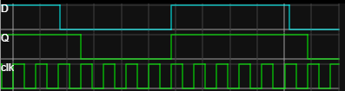
Truth Table
PRESET | CLEAR | Data | Clock | Q | Q bar
0 | 0 | X | X | X | X
0 | 1 | X | X | 1 | 0
1 | 0 | X | X | 0 | 1
1 | 1 | 0 | 1 | 0 | 1
1 | 1 | X | 0 | Q | Q bar
1 | 1 | 1 | 1 | 1 | 0

Slide 4
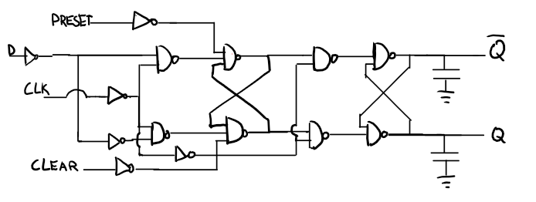
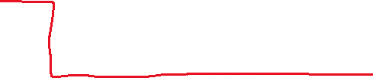
Design 1: INV-INV-NAND2-NAND3-NAND2-NAND2
Stages
U V W X Y Z

Slide 5
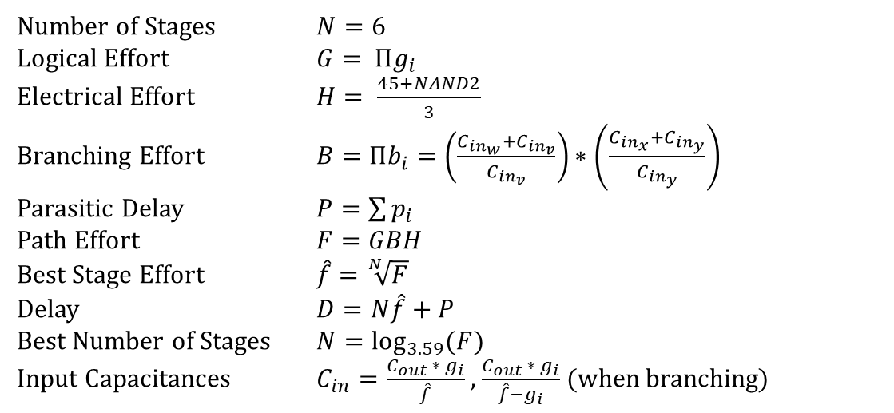
Design 1: Calculations
Iteration | Logical Effort G | Electrical Effort H | Branching Effort B | Parasitic Delay P | Path Effort F | Best Stage Effort f | Delay D | Delay (ns) | Best Number of Stages
1 | 3.950617284 | 16.33333333 | 5.25 | 11 | 338.765432 | 2.640279161 | 26.84167497 | 1.6105005 | 4.557601134
2 | 3.950617284 | 30.30285309 | 9.871846616 | 11 | 1181.80787 | 3.251555314 | 30.50933188 | 1.8305599 | 5.535178539
Iteration | Stage | Input Cap
1 | Z | 45.90856
 | Y | 23.18369
 | X | 39.68672
 | W | 20.04168
 | V | 7.590742
 | U | 10.46572
2 | Z | 31.27897
 | Y | 12.82626
 | X | 13.48808
 | W | 5.530922
 | V | 1.701008
 | U | 2.224145
Number of Stages $N=6$
Logical Effort $G= Πg_{i}$
Electrical Effort $H= \frac{45+NAND2}{3}$
Branching Effort $B=Πb_{i}=\left(\frac{C_{{in}_{w}}+C_{{in}_{v}}}{C_{{in}_{v}}}\right)∗\left(\frac{C_{{in}_{x}}+C_{{in}_{y}}}{C_{{in}_{y}}}\right)$
Parasitic Delay $P=\sum{p_{i}}$
Path Effort $F=GBH$
Best Stage Effort $\hat{f}=\sqrt[N]{F}$
Delay $D=N\hat{f}+P$
Best Number of Stages $N=\log_{3.59}{(F})$
Input Capacitances $C_{in}=\frac{C_{out} ∗ g_{i}}{\hat{f}}$ , $\frac{C_{out} ∗ g_{i}}{\hat{f}−g_{i}}$ (when branching)

Slide 6
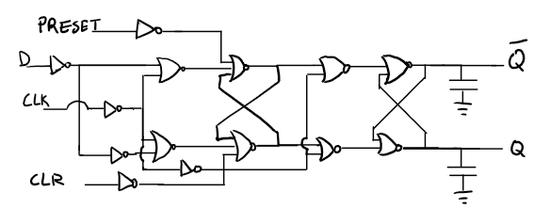
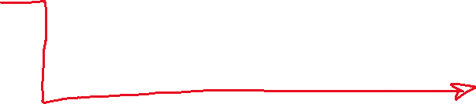
Design 2:
Inv-inv-nor2-nor3-nor2-nor2

Slide 7
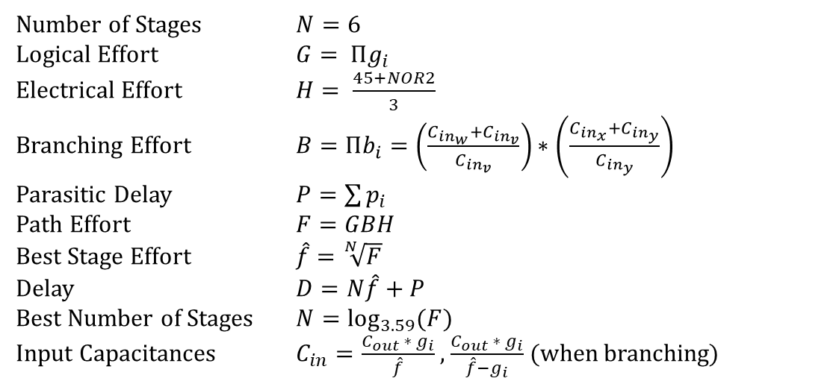
Design 2: Calculations
Iteration | Logical Effort G | Electrical Effort H | Branching Effort B | Parasitic Delay P | Path Effort F | Best Stage Effort f | Delay D | Delay (ns) | Best Number of Stages
1 | 10.80246914 | 16.66666667 | 6.4 | 11 | 1152.26337 | 3.237864173 | 30.42718504 | 1.8256311 | 5.515370881
2 | 10.80246914 | 30.91143055 | 15.16988474 | 11 | 5065.52449 | 4.14416848 | 35.86501088 | 2.1519007 | 6.673863212
Iteration | Stage | Sizing
1 | Z | 47.73429
 | Y | 24.57087
 | X | 63.38318
 | W | 32.62602
 | V | 10.0764
 | U | 13.18845
2 | Z | 30.27243
 | Y | 12.17471
 | X | 15.6876
 | W | 6.309106
 | V | 1.522406
 | U | 1.889767
Number of Stages $N=6$
Logical Effort $G= Πg_{i}$
Electrical Effort $H= \frac{45+NOR2}{3}$
Branching Effort $B=Πb_{i}=\left(\frac{C_{{in}_{w}}+C_{{in}_{v}}}{C_{{in}_{v}}}\right)∗\left(\frac{C_{{in}_{x}}+C_{{in}_{y}}}{C_{{in}_{y}}}\right)$
Parasitic Delay $P=\sum{p_{i}}$
Path Effort $F=GBH$
Best Stage Effort $\hat{f}=\sqrt[N]{F}$
Delay $D=N\hat{f}+P$
Best Number of Stages $N=\log_{3.59}{(F})$
Input Capacitances $C_{in}=\frac{C_{out} ∗ g_{i}}{\hat{f}}$ , $\frac{C_{out} ∗ g_{i}}{\hat{f}−g_{i}}$ (when branching)

Slide 8
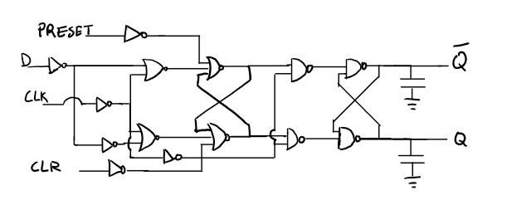
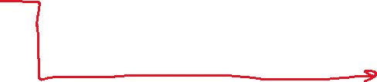
Design 3
Inv-inv-NOR2-nor3-nand2-nand2

Slide 9
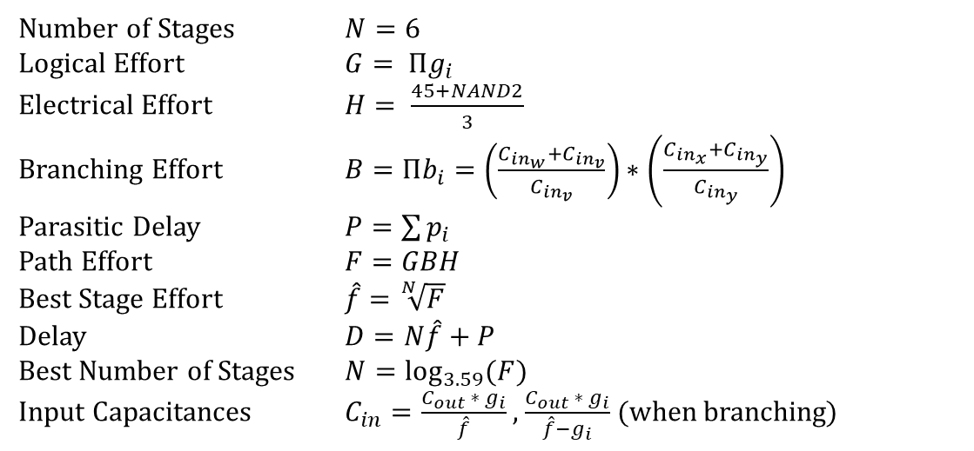
Design 3: Calculations
Iteration | Logical Effort G | Electrical Effort H | Branching Effort B | Parasitic Delay P | Path Effort F | Best Stage Effort f | Delay D | Delay (ns) | Best Number of Stages
1 | 6.913580247 | 16.33333333 | 7.333333333 | 11 | 828.093278 | 3.064407688 | 29.38644613 | 1.7631868 | 5.25690586
2 | 6.913580247 | 26.55351874 | 17.03657376 | 11 | 3127.57221 | 3.824146819 | 33.94488091 | 2.0366929 | 6.296599353
Iteration | Stage | Input Cap
1 | Z | 34.66056
 | Y | 15.08092
 | X | 48.133
 | W | 26.17852
 | V | 8.542768
 | U | 11.33051
2 | Z | 24.08852
 | Y | 8.398742
 | X | 13.14521
 | W | 5.72904
 | V | 1.498123
 | U | 1.889876
Number of Stages $N=6$
Logical Effort $G= Πg_{i}$
Electrical Effort $H= \frac{45+NAND2}{3}$
Branching Effort $B=Πb_{i}=\left(\frac{C_{{in}_{w}}+C_{{in}_{v}}}{C_{{in}_{v}}}\right)∗\left(\frac{C_{{in}_{x}}+C_{{in}_{y}}}{C_{{in}_{y}}}\right)$
Parasitic Delay $P=\sum{p_{i}}$
Path Effort $F=GBH$
Best Stage Effort $\hat{f}=\sqrt[N]{F}$
Delay $D=N\hat{f}+P$
Best Number of Stages $N=\log_{3.59}{(F})$
Input Capacitances $C_{in}=\frac{C_{out} ∗ g_{i}}{\hat{f}}$ , $\frac{C_{out} ∗ g_{i}}{\hat{f}−g_{i}}$ (when branching)

Slide 10
Design Comparison
Design | Worst Path | Delay | Delay (ns)
1 | INV-INV-NAND2-NAND3-NAND2-NAND2 | 30.50933188 | 1.8305599
2 | INV-INV-NOR2-NOR3-NOR2-NOR2 | 35.86501088 | 2.1519007
3 | INV-INV-NOR2-NOR3-NAND2-NAND2 | 33.94488091 | 2.0366929

Slide 11
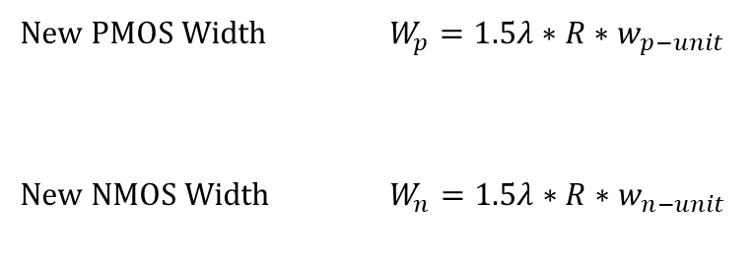
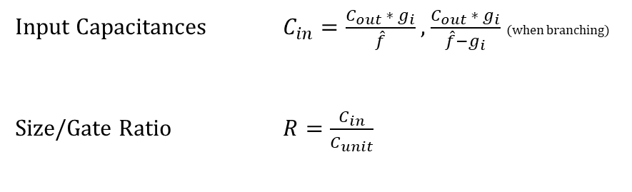
Cadence Size Optimization
Stage | Gate | Input Cap | Unit Cap | Gate Ratio | PMOS Width | NMOS Width | PMOS Width (After Folding) | NMOS Width (After Folding) | Fold? | Load capacitance (fF)
Z | 2NAND | 31.27896594 | 4 | 7.8197415 | 23.45922445 | 23.45922445 | 11.72961223 | 11.72961223 | Yes | 90
Y | 2NAND | 12.82625817 | 4 | 3.2065645 | 9.619693629 | 9.619693629 | 9.619693629 | 9.619693629 | No | 62.55793188
X | 3NAND | 13.48807501 | 5 | 2.697615 | 8.092845004 | 12.13926751 | 8.092845004 | 12.13926751 | Yes | 25.65251634
W | 2NAND | 5.530922365 | 4 | 1.3827306 | 4.148191774 | 4.148191774 | 4.148191774 | 4.148191774 | No | 26.97615001
V | INV | 3 | 3 | 1 | 3 | 1.5 | 3 | 1.5 | No | 11.06184473
U | INV | 3 | 3 | 1 | 3 | 1.5 | 3 | 1.5 | No | 6
Input Capacitances $C_{in}=\frac{C_{out} ∗ g_{i}}{\hat{f}}$ , $\frac{C_{out} ∗ g_{i}}{\hat{f}−g_{i}}$ (when branching)
Size/Gate Ratio $R=\frac{C_{in}}{C_{unit}}$
New PMOS Width $W_{p}=1.5λ∗R∗w_{p−unit}$
New NMOS Width $W_{n}=1.5λ∗R∗w_{n−unit}$
$w_{n−unit} and w_{p−unit}$ refers to standard unit size of NMOS, PMOS, respectively

Slide 12
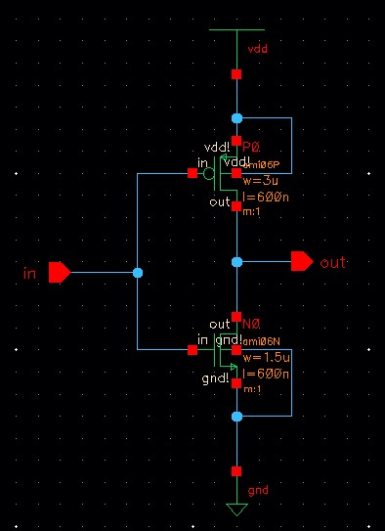
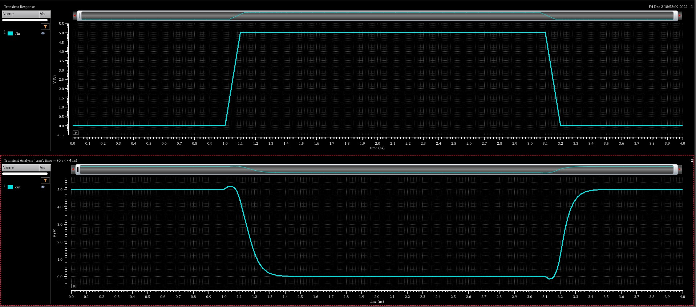
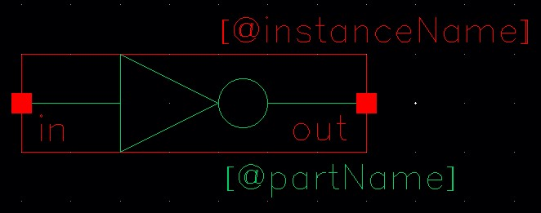
Inverters (stages U & V)
Standard Cell Library: Schematics

Slide 13
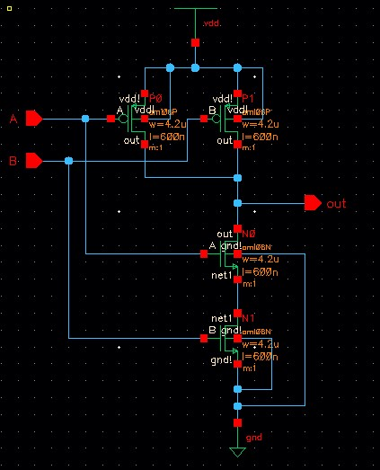
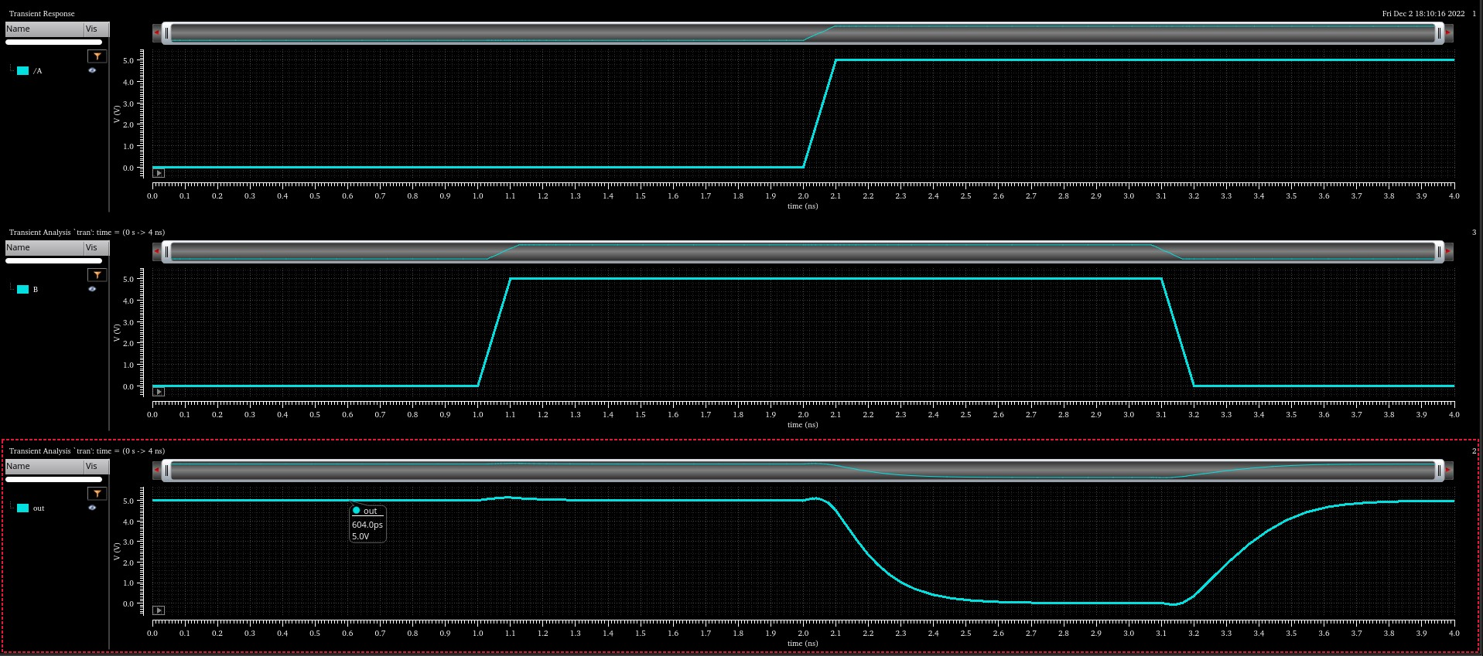
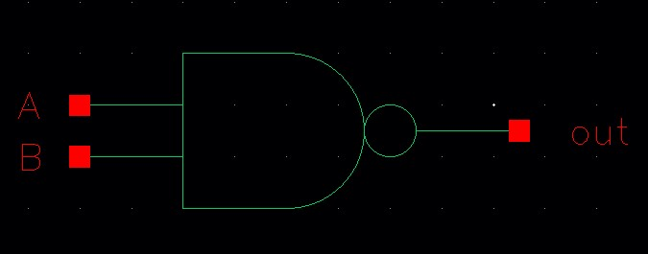
2-Input NAND (stage W)
Standard Cell Library: Schematics

Slide 14
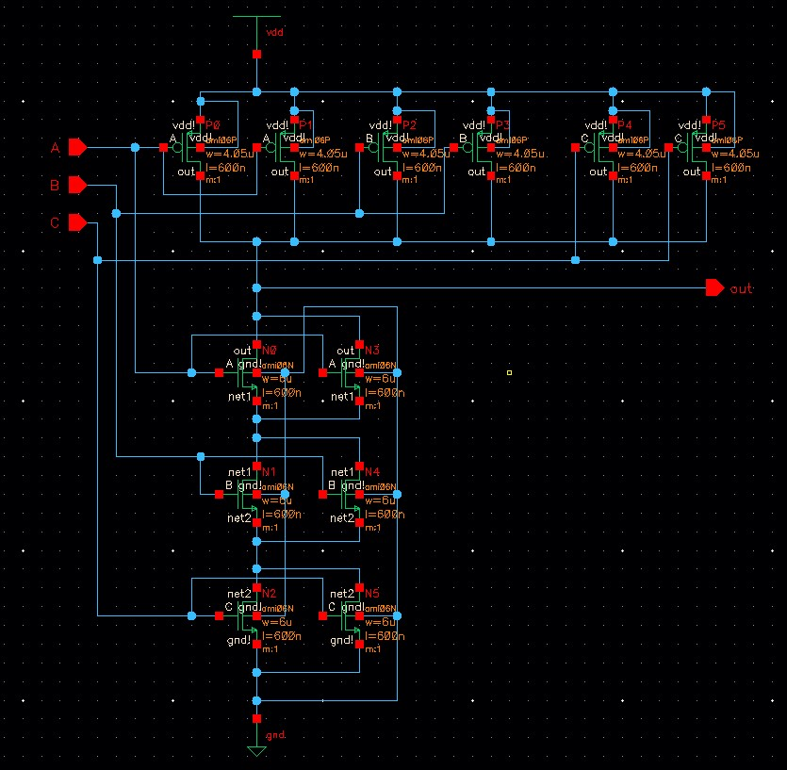
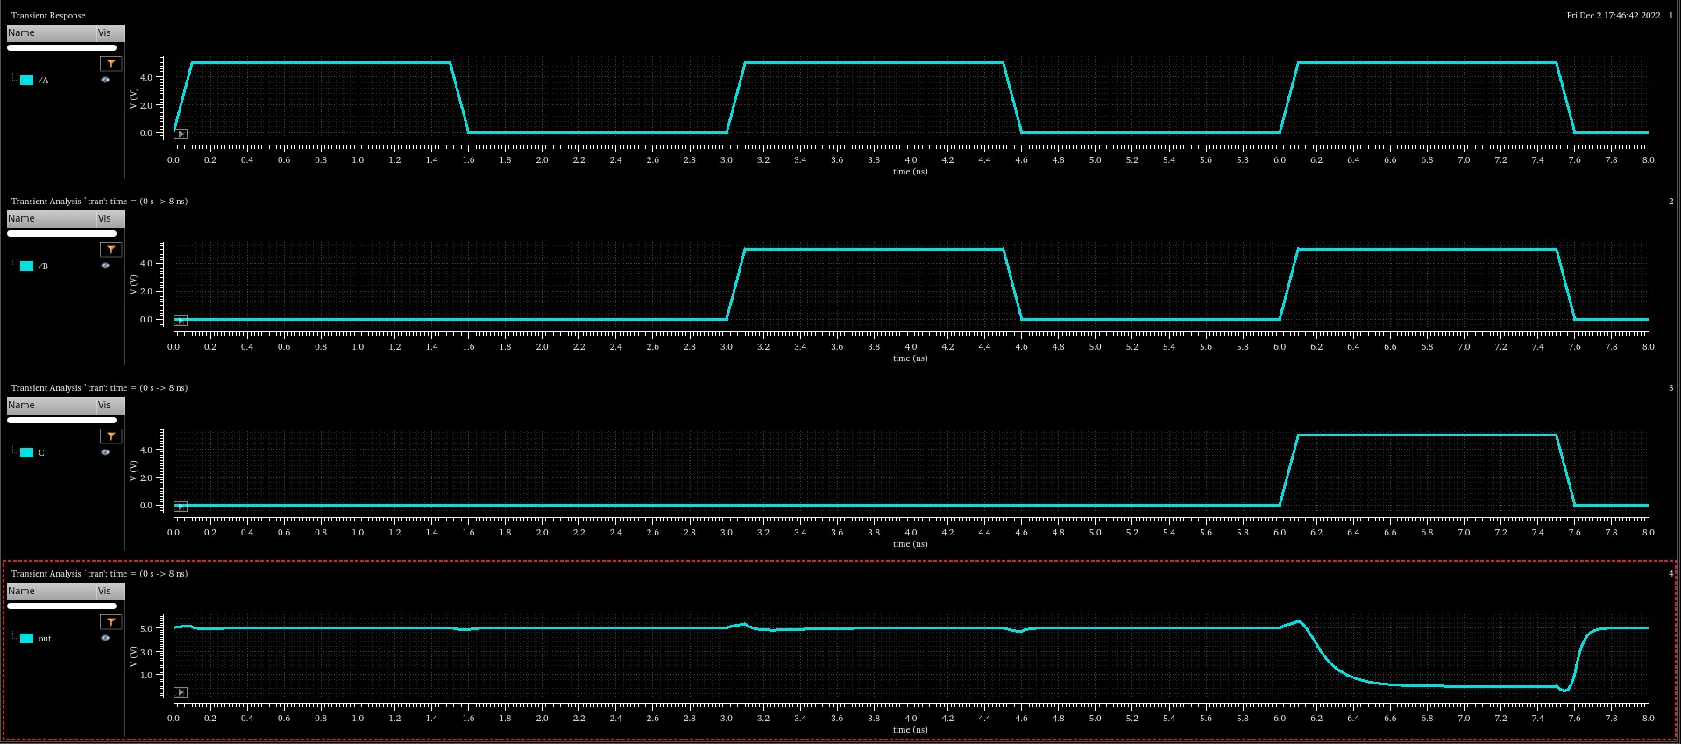
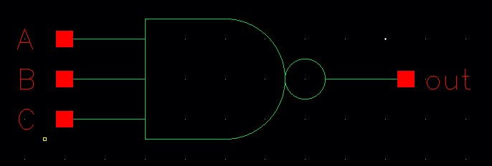
3-Input NAND (stage X)
Standard Cell Library: Schematics

Slide 15
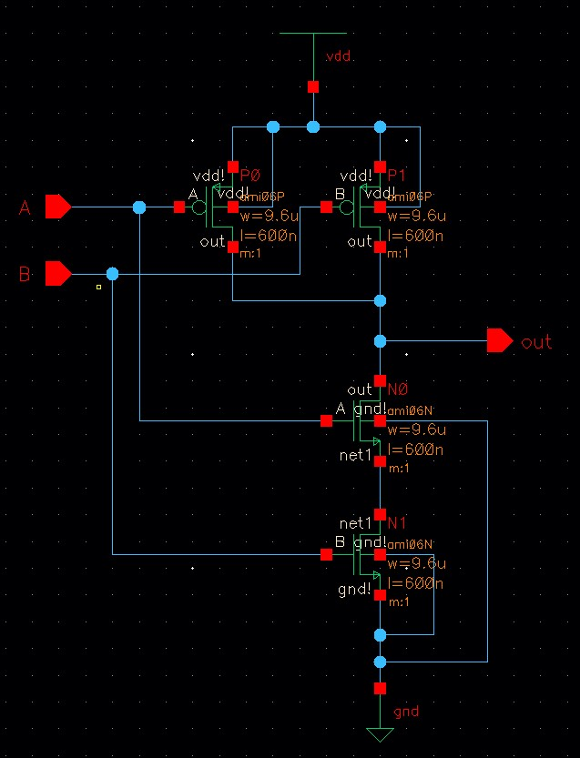
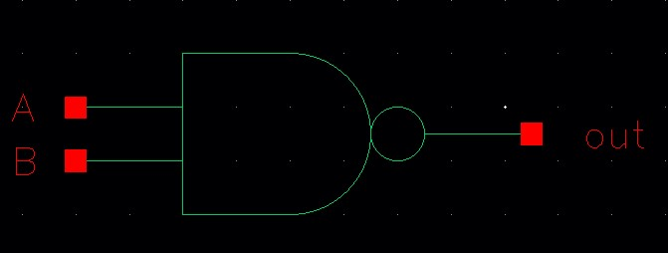
2-Input NAND (stage Y)
Standard Cell Library: Schematics

Slide 16
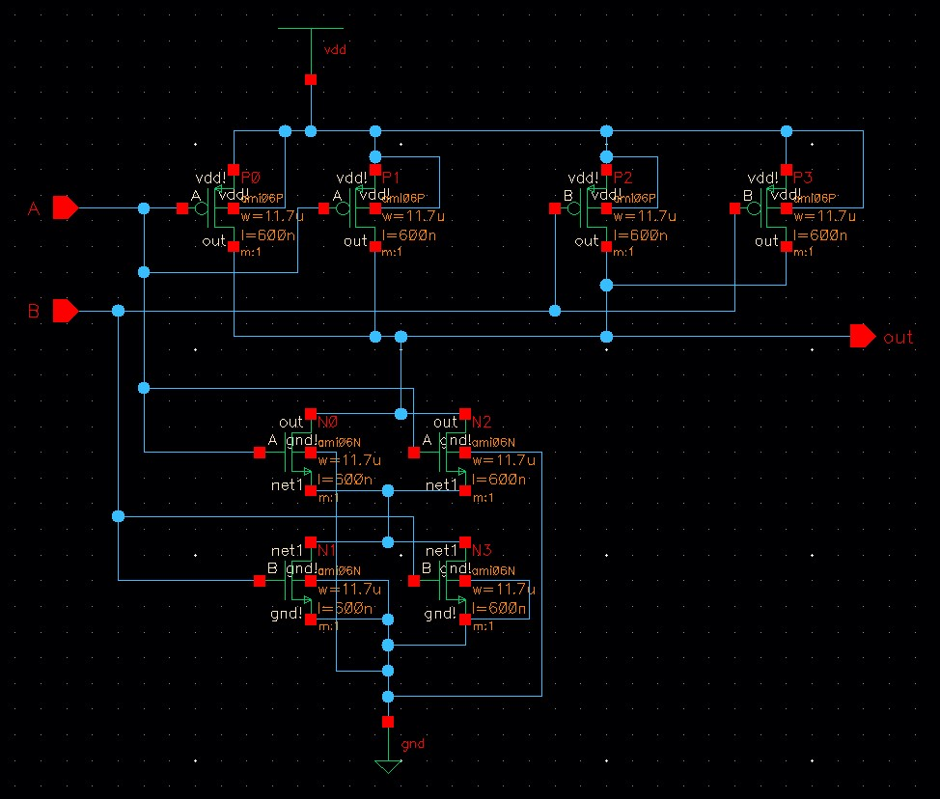
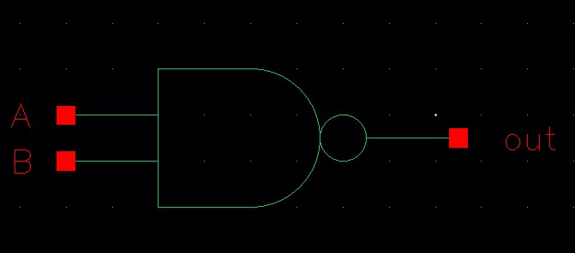
2-Input NAND (stage Z)
Standard Cell Library: Schematics

Slide 17
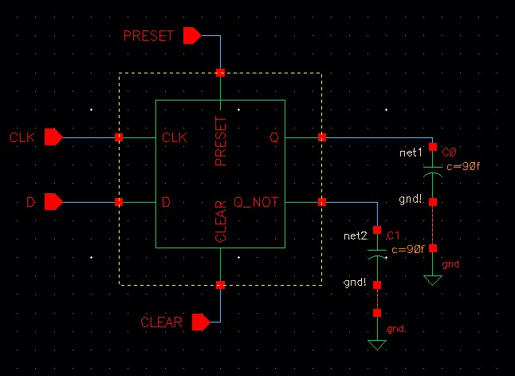
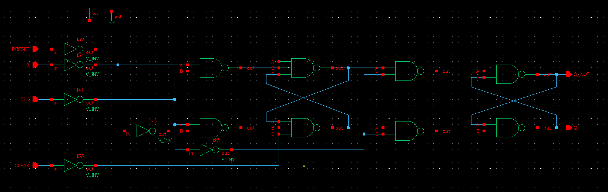
Standard Cell Library: Full sChematic

Slide 18
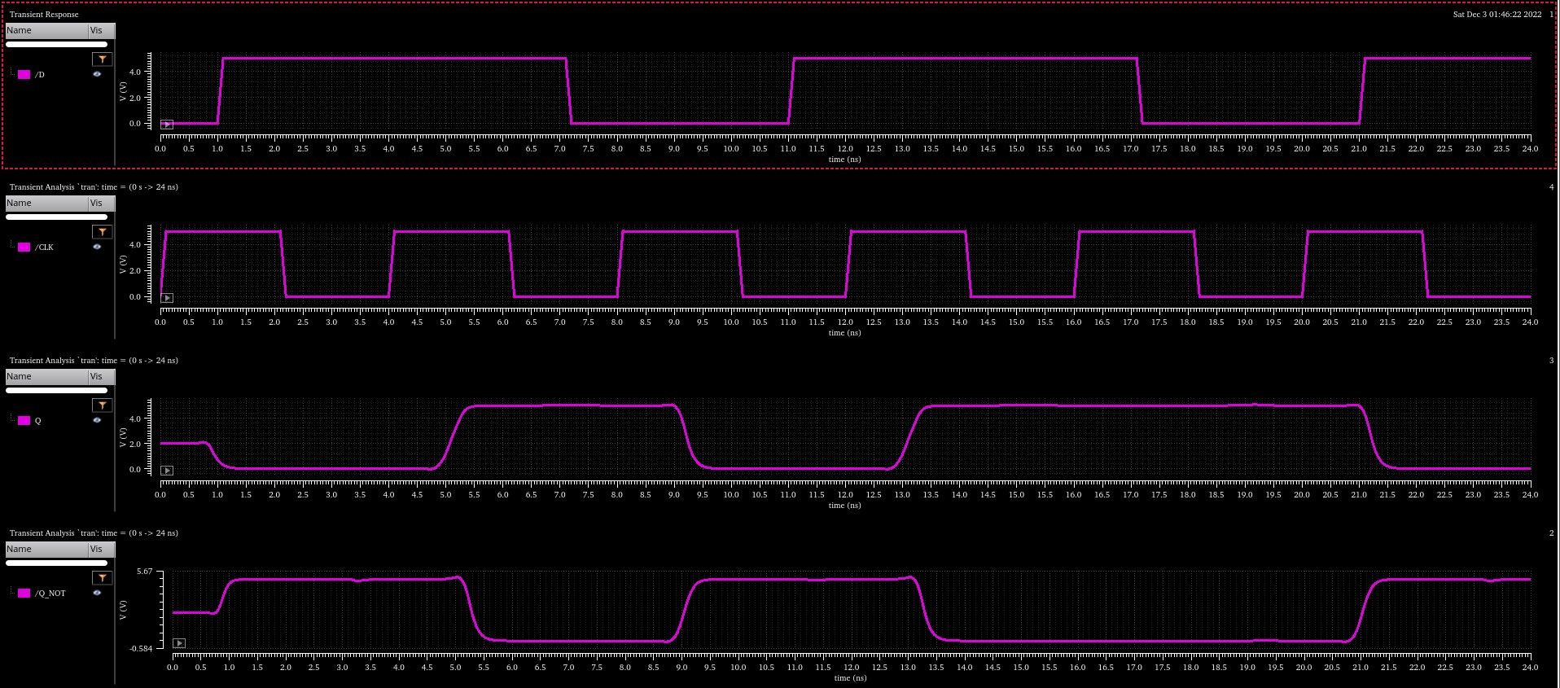
Standard Cell Library: Full sChematic Simulation

Slide 19
Schematic Simulation Results
Stage | Gate | Fall Time (ps) | Rise Time (ps) | PDF (ps) | PDR (ps) | APD (ps)
Z | 2NAND | 125.2 | 179.4 | 103.9 | 148.6 | 126.25
Y | 2NAND | 165.7 | 224 | 131 | 178.2 | 154.6
X | 3NAND | 178.3 | 55.99 | 195.6 | 69.89 | 132.745
W | 2NAND | 179.4 | 237.9 | 142.4 | 192.2 | 167.3
V | INV | 139.4 | 106.7 | 138.9 | 96.66 | 117.78
U | INV | 100.8 | 79.18 | 110.4 | 76.77 | 93.585
 |  |  |  |  | Total (sum) = | 792.26
Full Schematic Results
Fall Time (ps) | Rise Time (ps) | PDF (ns) | PDR (ns) | APD (ns)
203.9 | 272 | 1.169 | 1.06 | 1.1145

Slide 20
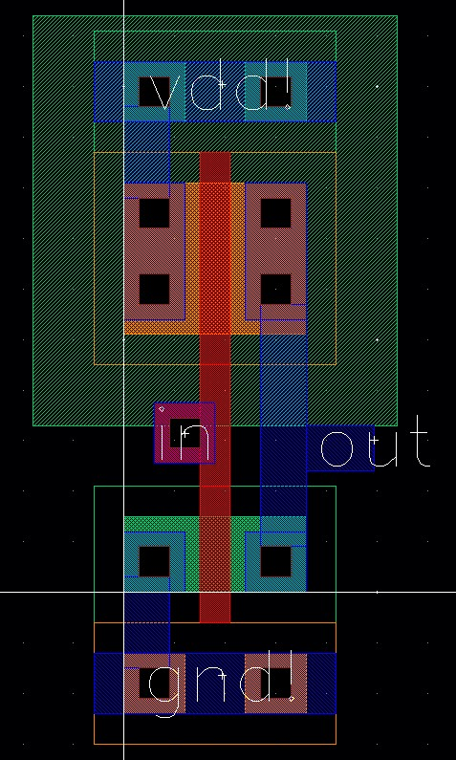
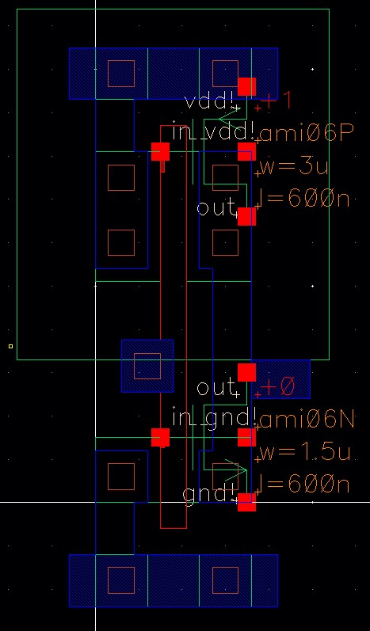
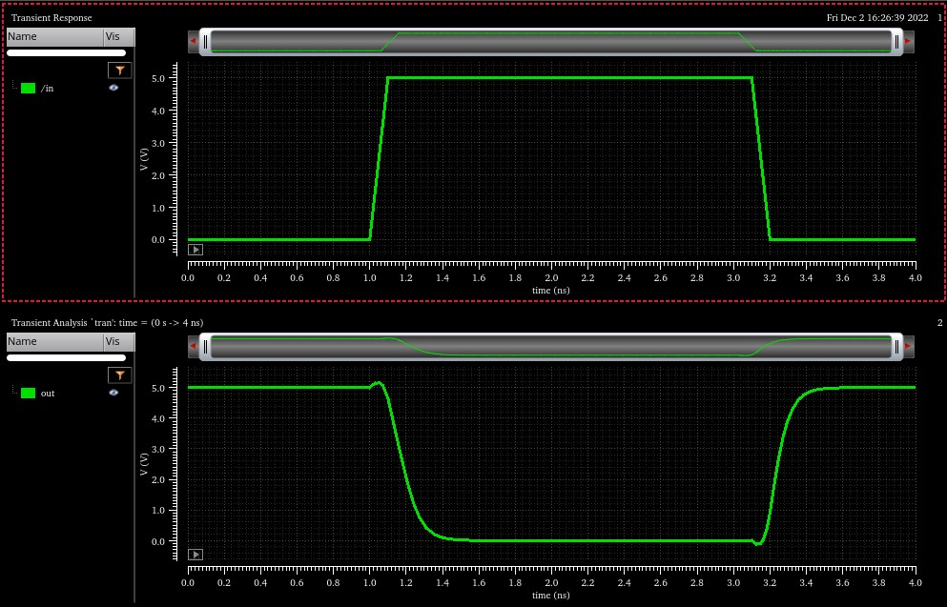
Inverters (stages U & V)
Standard Cell Library: Layout

Slide 21
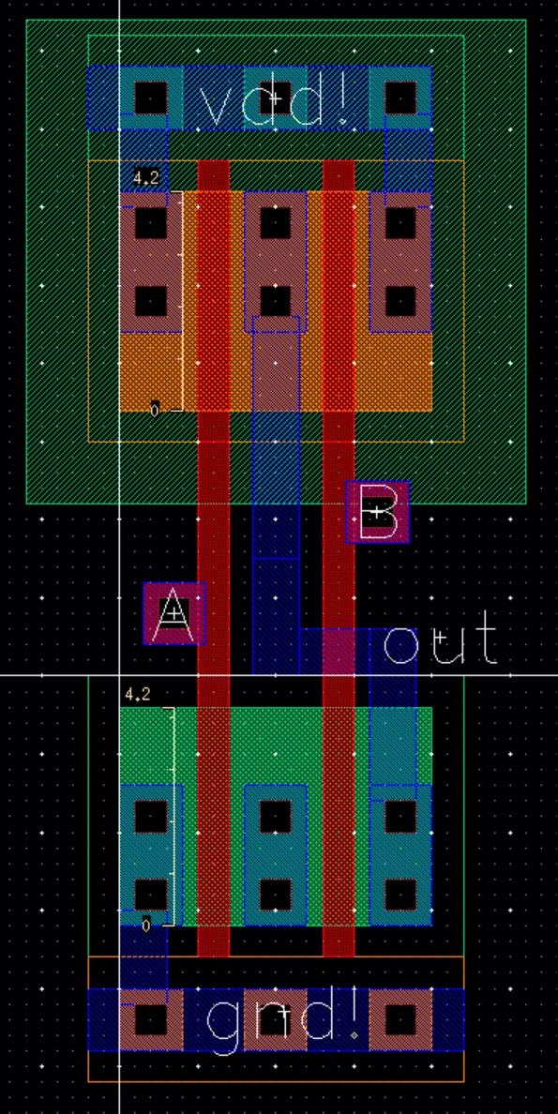
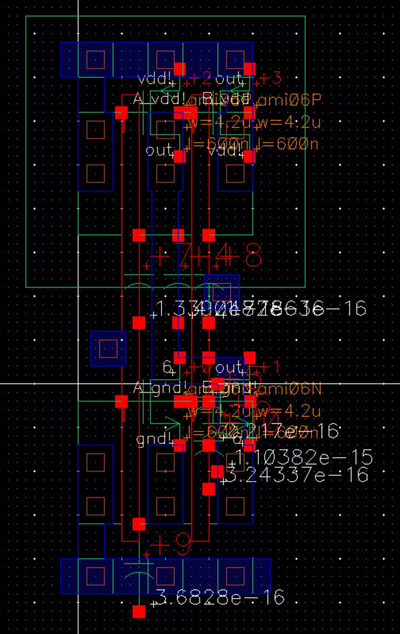
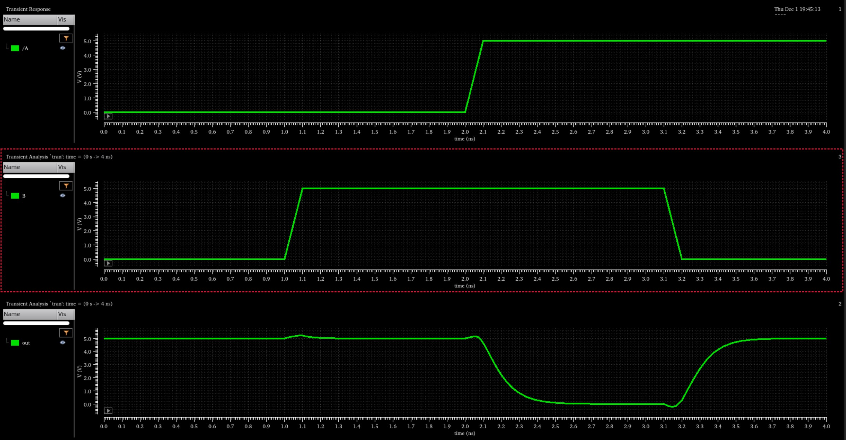
2-input NAND (stage w)
Standard Cell Library: Layout

Slide 22
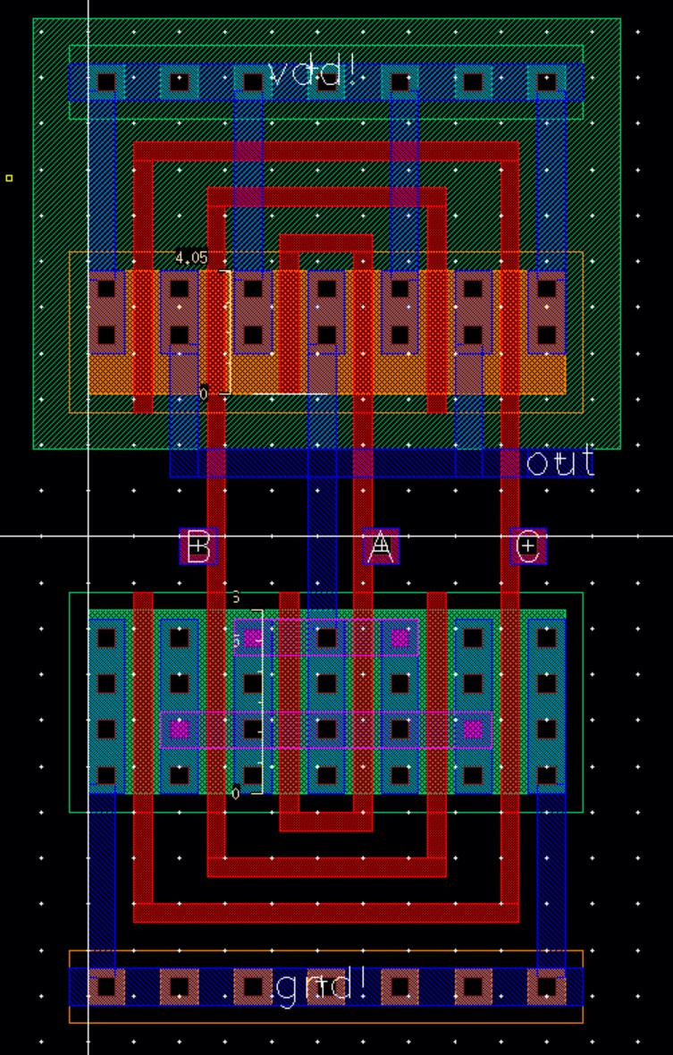
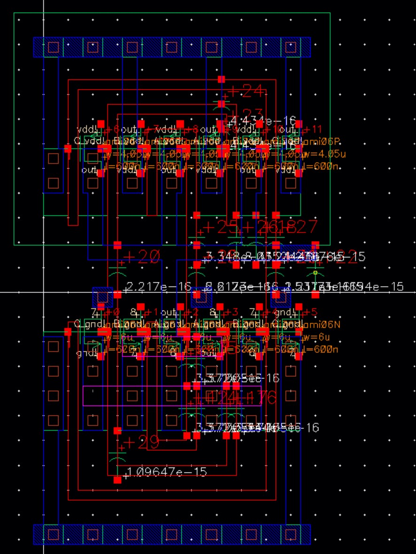
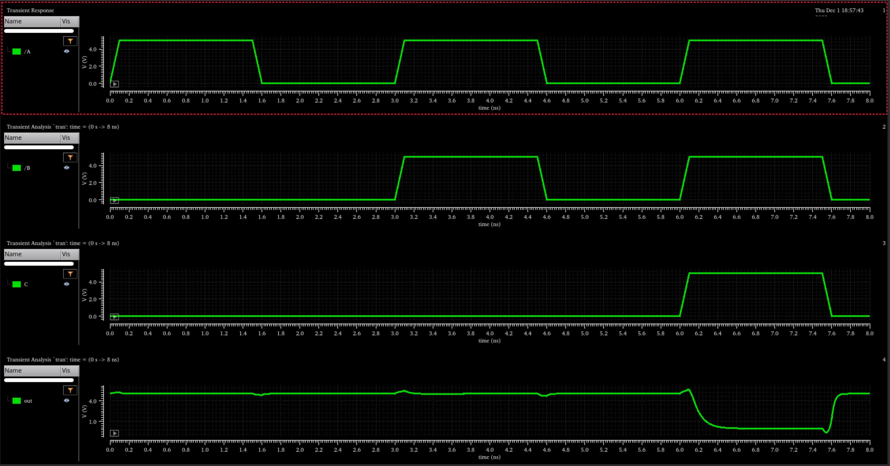
3-input NAND (stage x)
Standard Cell Library: Layout

Slide 23
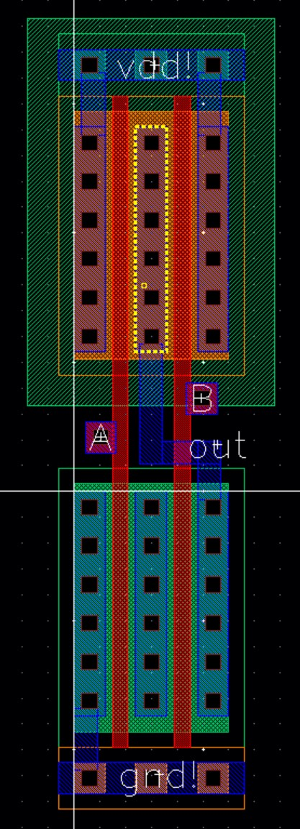
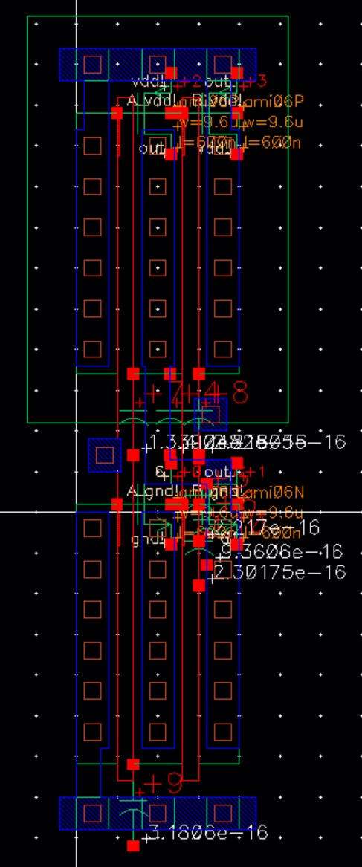
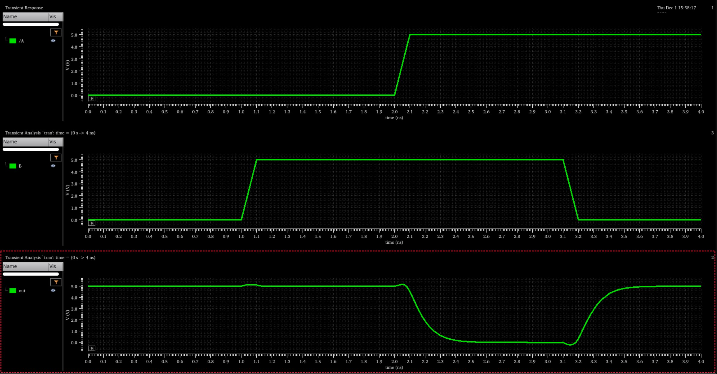
2-input NAND (stage Y)
Standard Cell Library: Layout

Slide 24
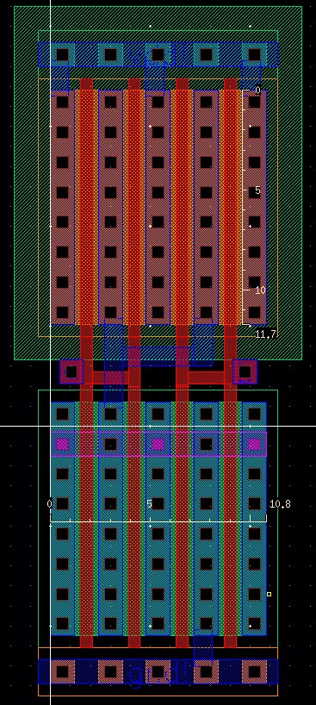
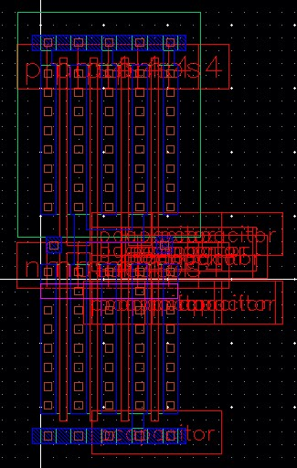
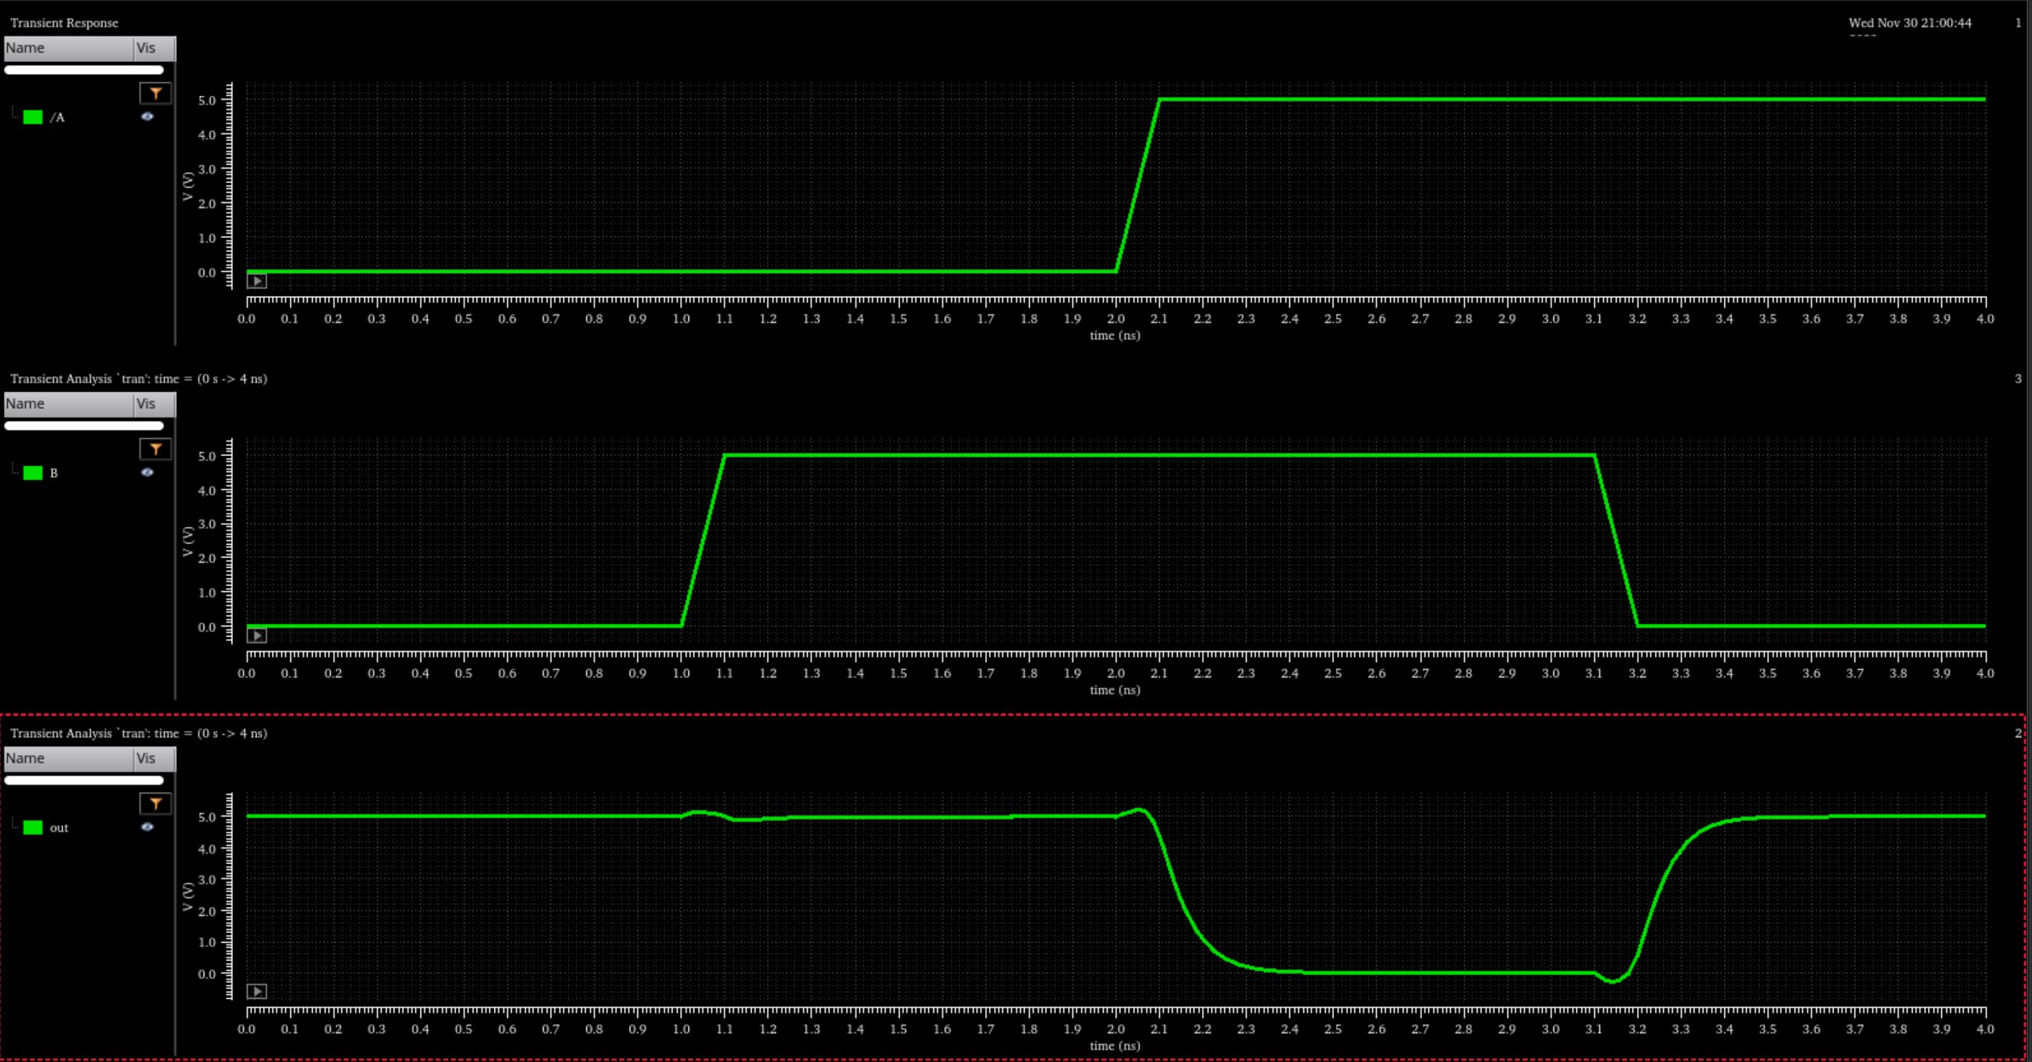
2-input NAND (stage z)
Standard Cell Library: Layout

Slide 25
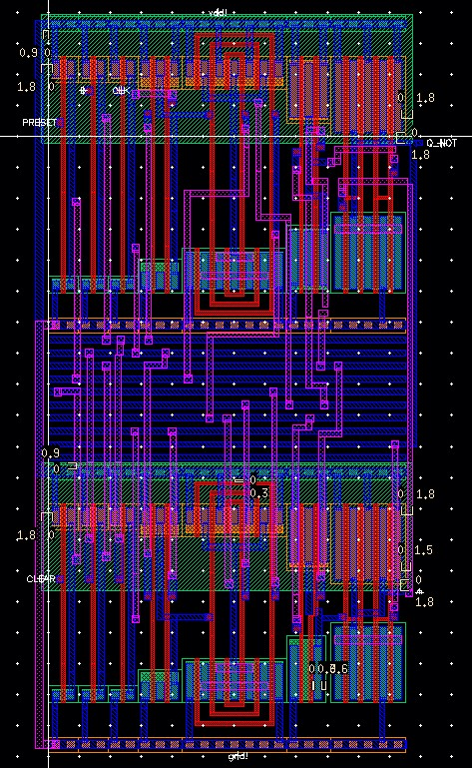
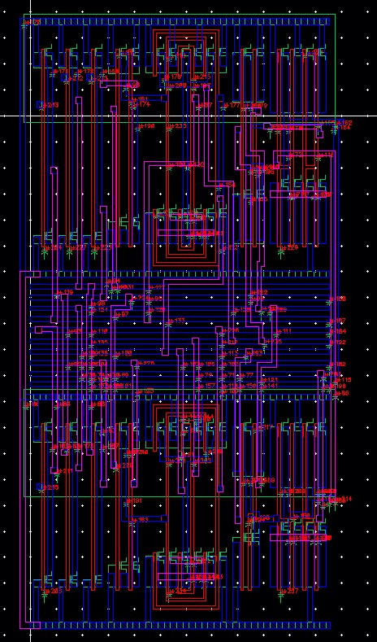
Snap-Together Standard Cell Layout

Slide 26
Standard Cell Layout Simulation Results
Stage | Gate | Fall Time (ps) | Rise Time (ps) | PDF (ps) | PDR (ps) | APD (ps)
Z | 2NAND | 95.72 | 94.42 | 94.56 | 95.74 | 95.15
Y | 2NAND | 140.2 | 145.6 | 122.6 | 130.2 | 126.4
X | 3NAND | 129.6 | 42.93 | 144.3 | 61.42 | 102.86
W | 2NAND | 156.2 | 157.6 | 137.4 | 141.3 | 139.35
V | INV | 131.3 | 101.2 | 132.6 | 92.18 | 112.39
U | INV | 92.67 | 75.57 | 103.9 | 72.7 | 88.3
 |  |  |  |  | Total (sum) = | 664.45
Snap-together layout simulation in progress
(currently a failed LVS)

Slide 27
Delay Comparisons
Source | Delay (ns)
Calculation | 1.83055991
Schematic: Sums | 0.79226
Schematic: Full | 1.1145
Layout: Sums | 0.66445
Layout: Snap-together | TBD

Slide 28
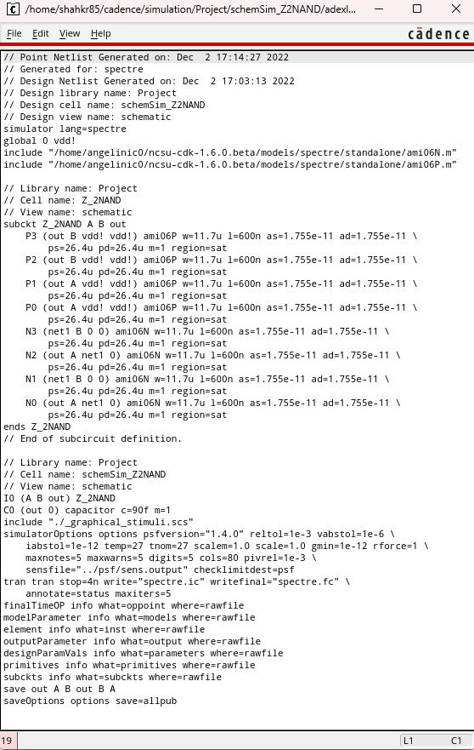
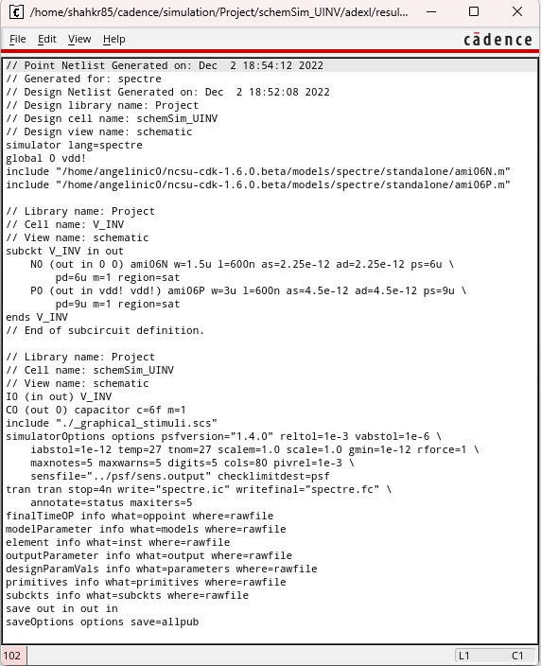
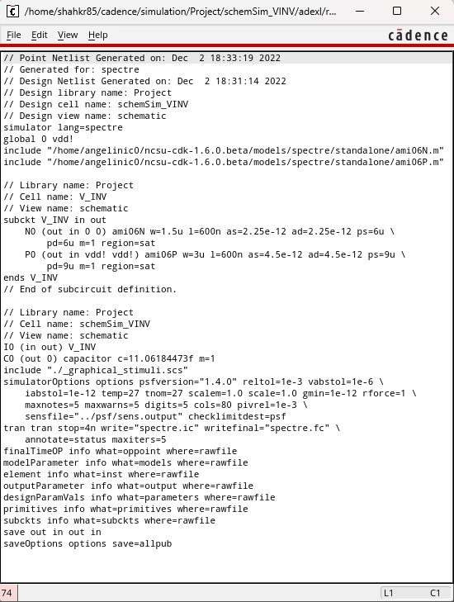
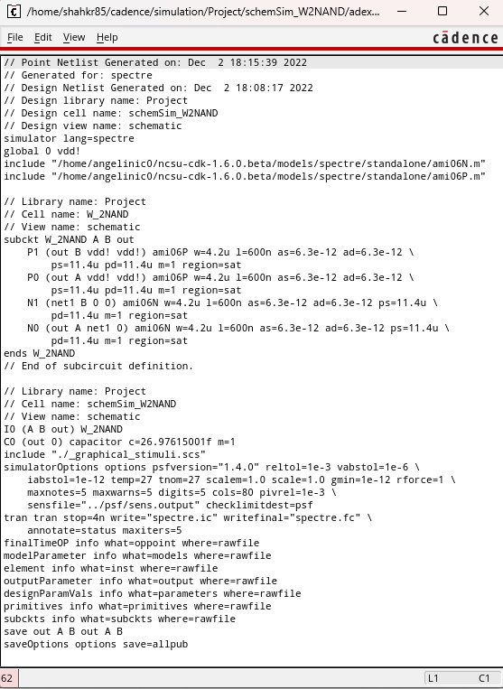
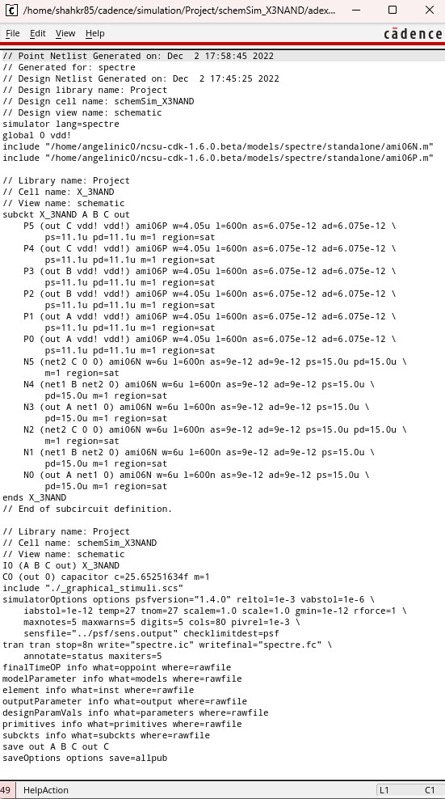

Netlists

